Slide 1

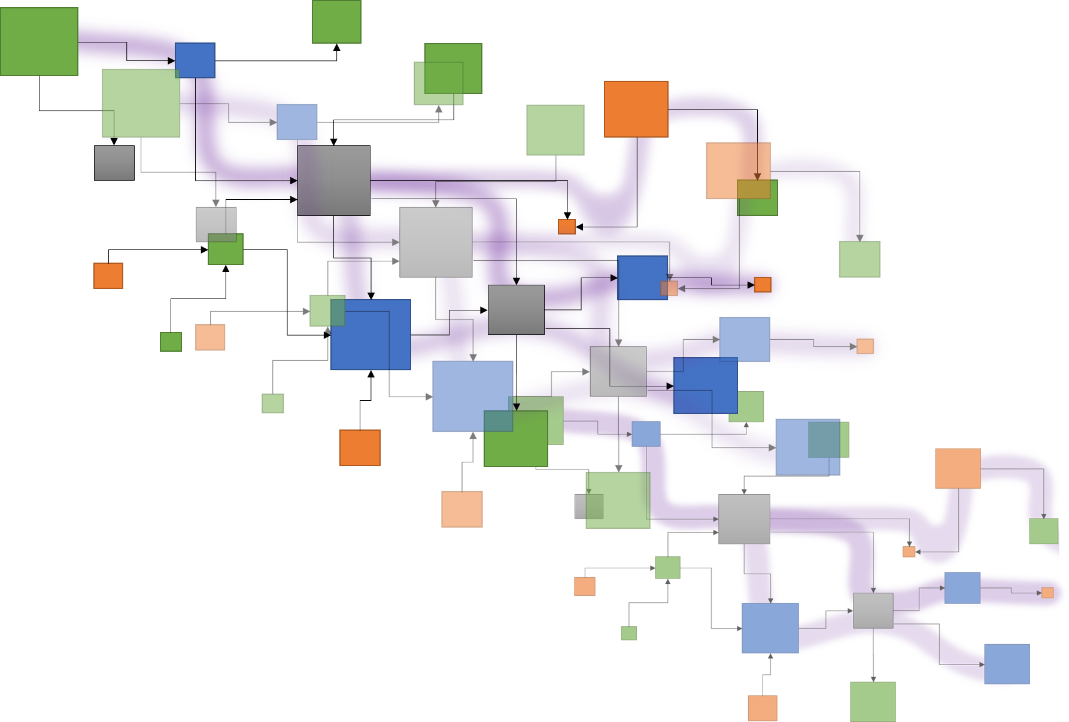
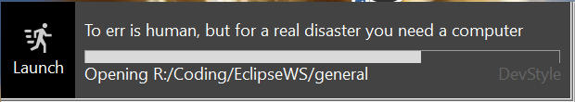





Tracea – 6th deliverable
Reference forensic
Deliverable 6
Exploring Papyrus typology
Traceα
A study of Papyrus:
Topology and complexity of
DSL orchestration
Edouard R. Batot
Mai 2022

Slide 2
Tracea – 6th deliverable
A study of Papyrus –
Topology and complexity of DSL orchestration..
Reference forensic
.. a semi-automated analysis
Task 6:
Evaluation of the potential advantages of using the distance valuation for dealing with the complexity of traceability. Potential study case: establish a heat chart for the change impact analysis.
Exploring Papyrus DSL orchestration
Deliverable 6:
Case study. Exploration of different scenarios that would benefit from a socio-technical traceability language or distance functions to reduce accidental complexity thanks to tracing. (For example: customization of views according to the "distance" between the artefacts on a matrix heat chart).
Edouard R. Batot
Mai 2022

Slide 3
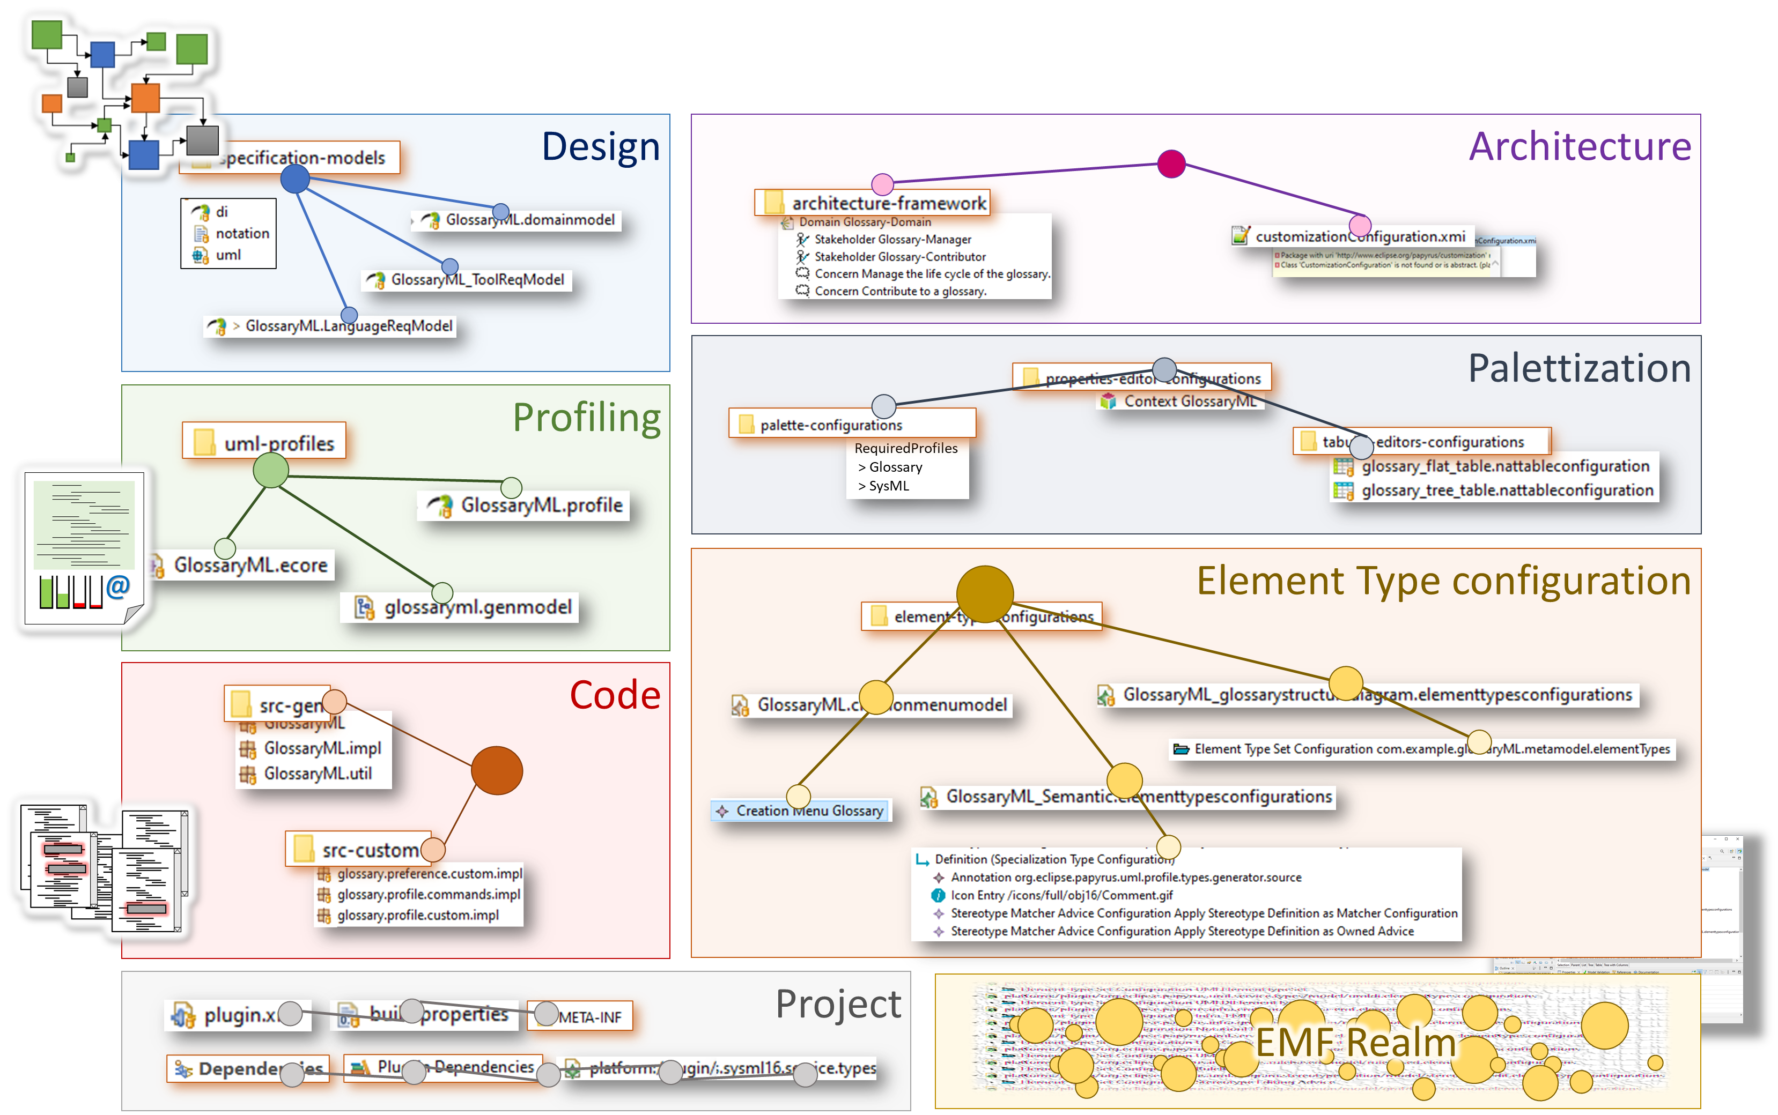
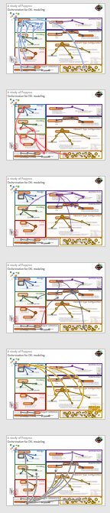
Orchestration for DSL modeling: A study of Papyrus
Papyrus modules & dependencies
Exploring Papyrus DSL orchestration

Slide 4
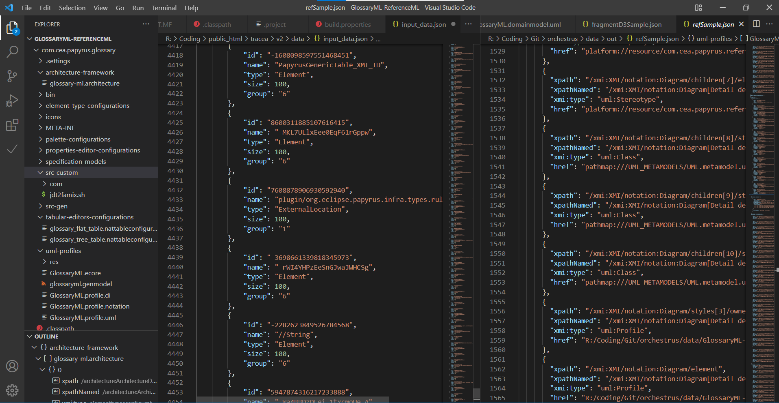
Persistence break.
Reference forensic
XMI
Artefacts
Configuration
Exploring Papyrus DSL orchestration
Custom
Java
Modeling
persistence

Slide 5
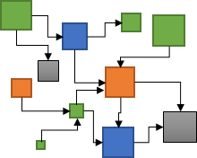
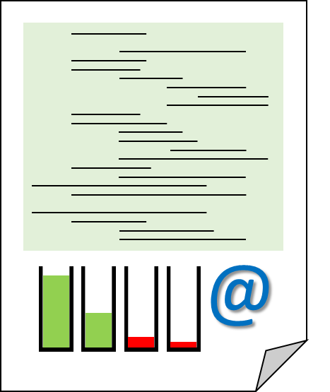
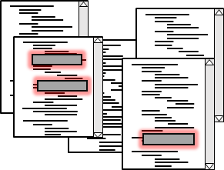
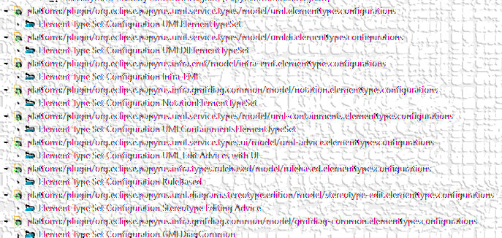
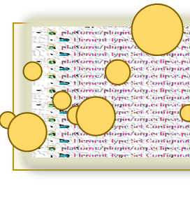
Reference forensic.
What is a reference
Nature, source
Solvability
What matters in a reference
Source file, target,
Frequency?
Reference forensic
XMI
XML et al.
Exploring Papyrus DSL orchestration
"href": "platform://plugin/org.eclipse.papyrus.uml.service.types/model/
uml.elementtypesconfigurations
#_ScP1oFYCEeS0WsAAtVmToA"
Java files
HREF
Protocol
://
location
Context
name
#
File artefacts
innerlocation
URI
Precise target element
SysML
Ecore
EMF Realm

Slide 6
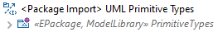

Reference forensic.
Root folder
Reference forensic
Root
Path to element
Path to element
External Element
Path to element
UML primitive
Exploring Papyrus DSL orchestration
Related
libraries
External Element
View
Context
SysML/Req
Local Element
Design
Architecture
Palettization
External location
Local file
Profiling
Element Type configuration
Code
Related project
Project
EMF Realm
Local root

Slide 7
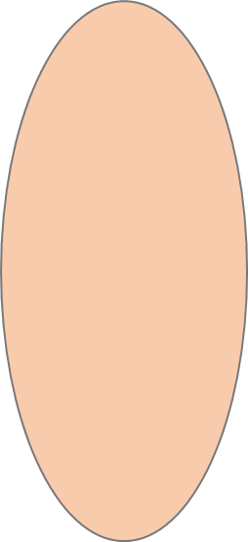
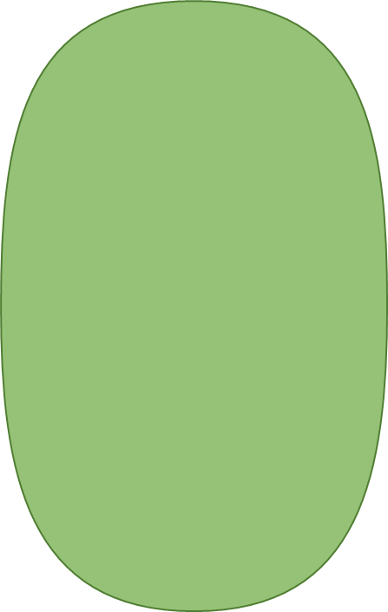
Reference forensic.
Reference forensic
Exploring Papyrus DSL orchestration
Dependences
Related
Projects
External locations
Unresolved locations

Slide 8
Reference forensic.
Impacted elements
Reference forensic
Design
Inter-module connections map
Code
Profiling
Maps modules external dependencies
Eases exploration of dependencies
Guides connections typing
Exploring Papyrus DSL orchestration
Architecture
Element Type configuration
Palettization

Slide 9
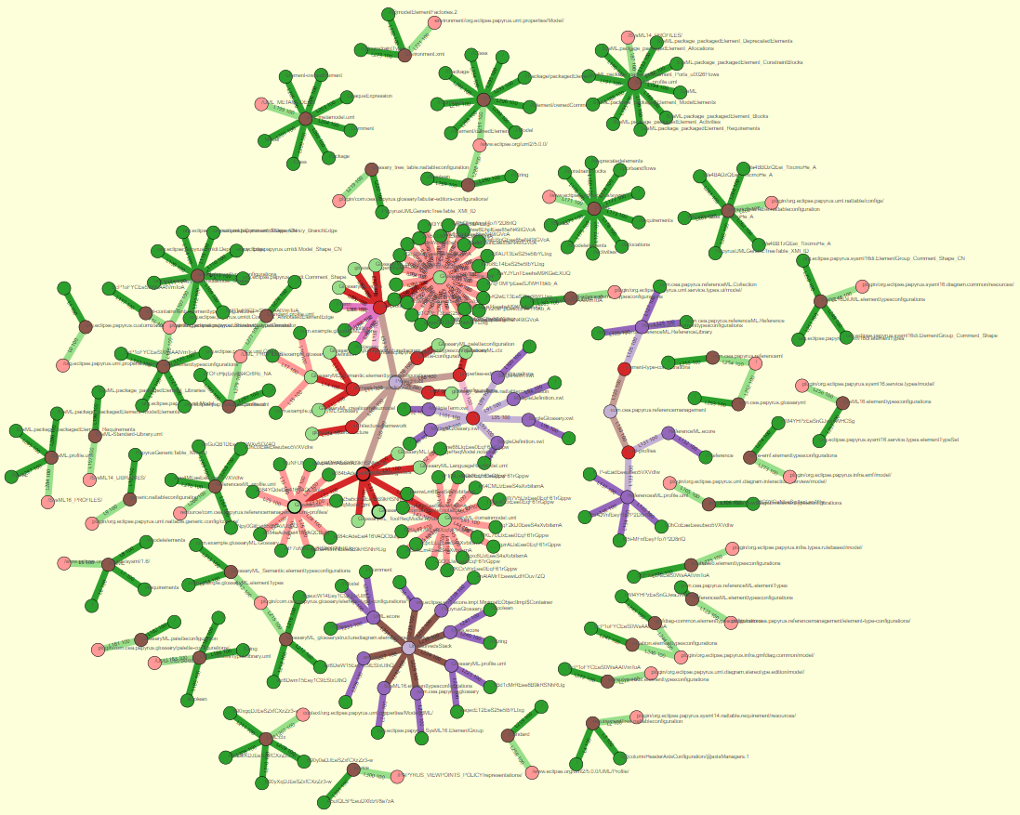
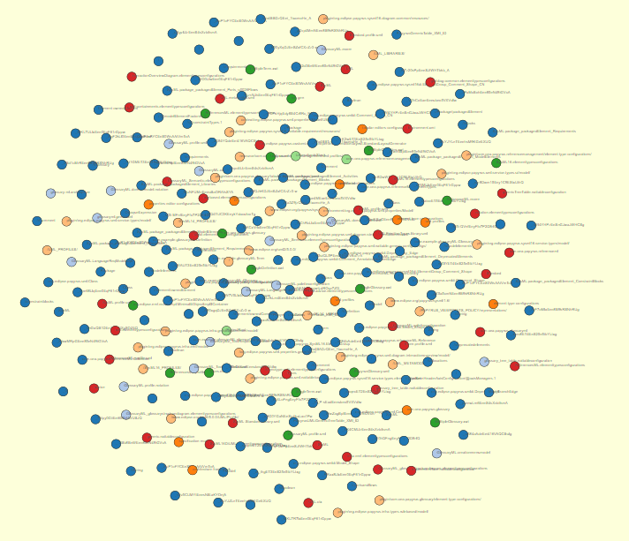
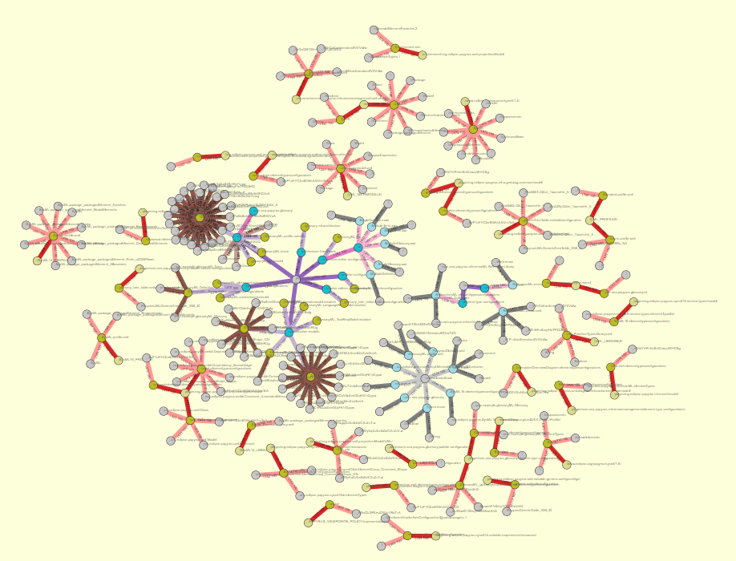
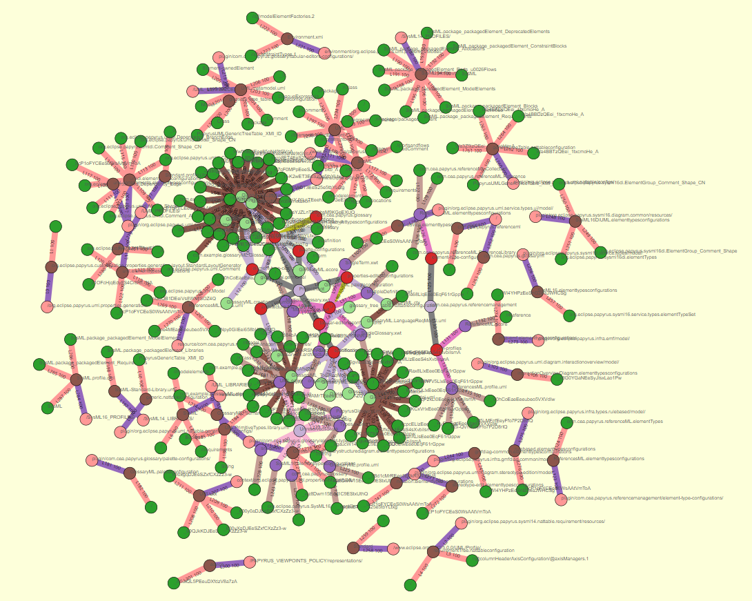
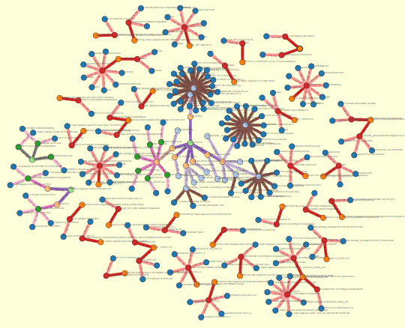
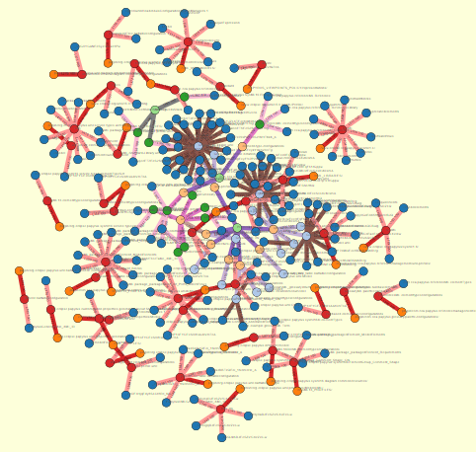
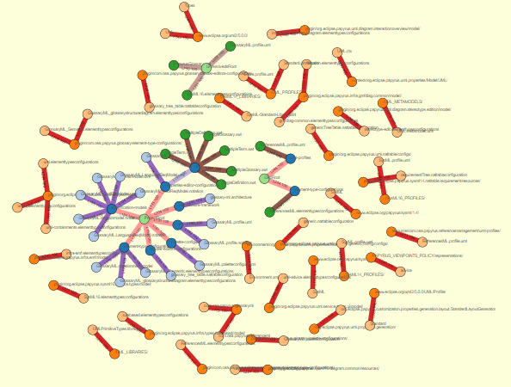
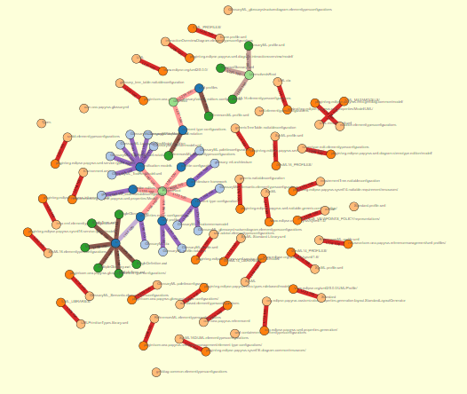
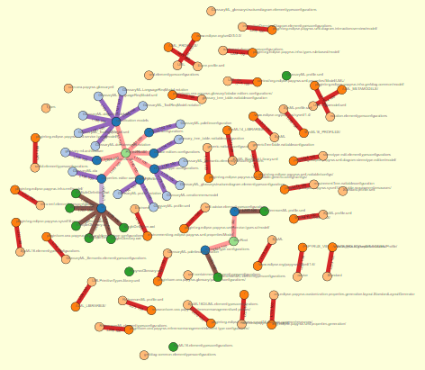
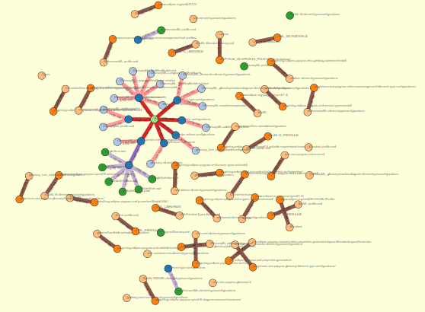
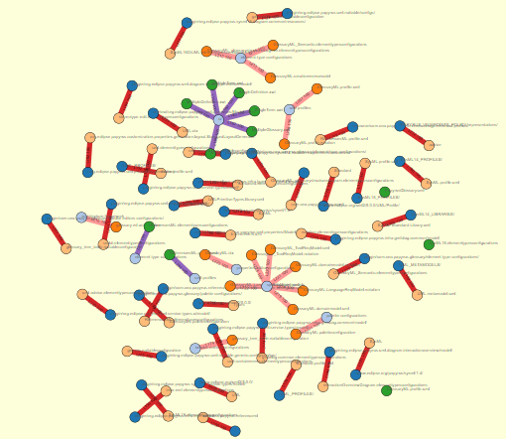
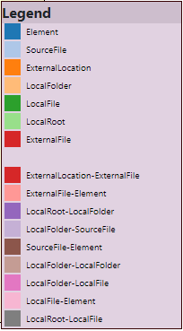
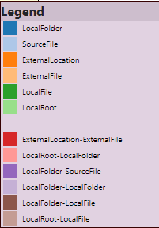
Topology of
a Papyrus project
Topology
Exploring Papyrus DSL orchestration
data/input_trace_data.json&nc=4&lc=4

Slide 10
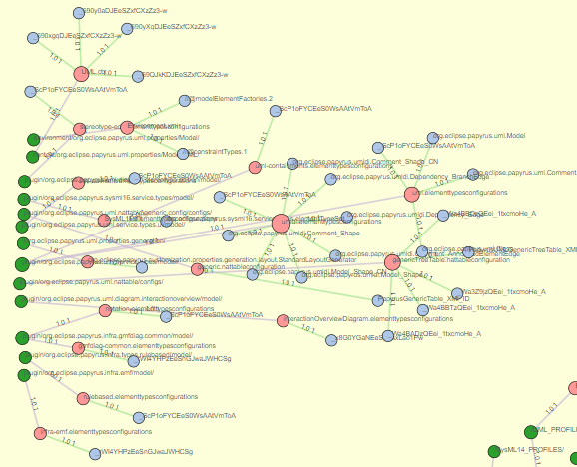
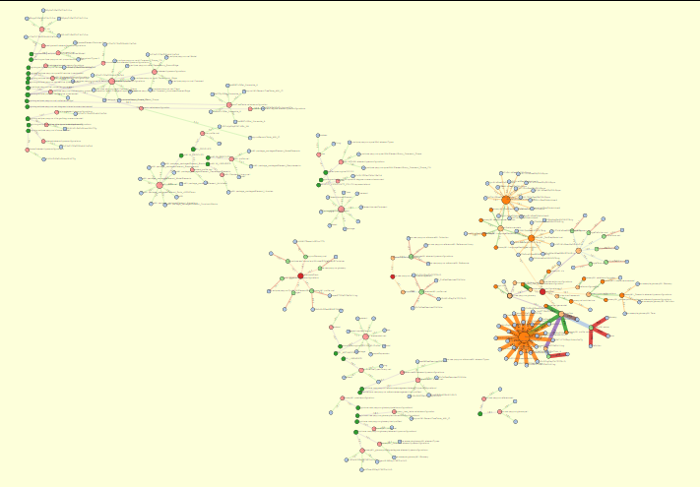
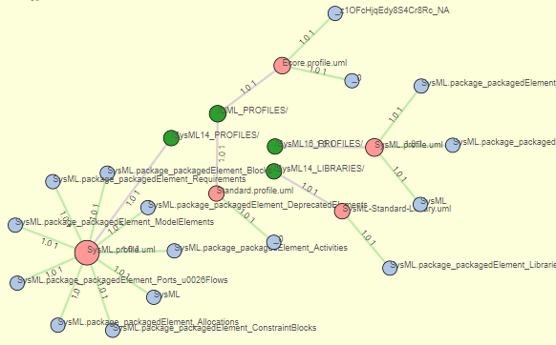
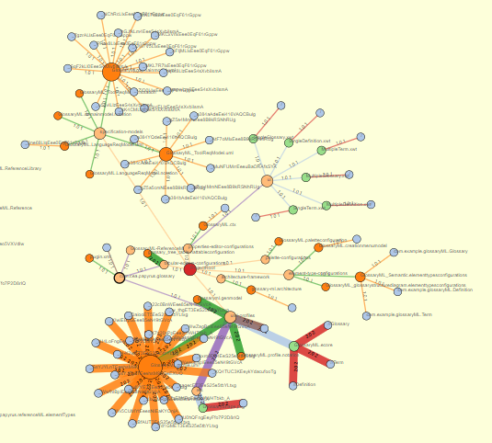
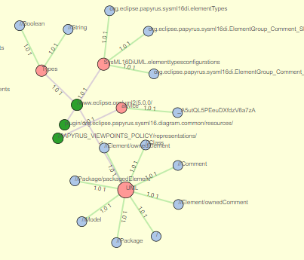
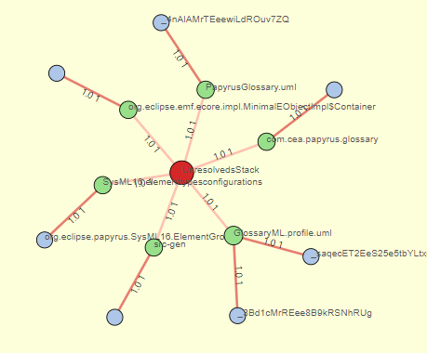
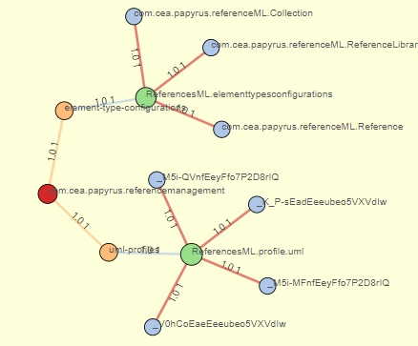
Complexity in
a Papyrus project
Reference forensic
Papyrus
Exploring Papyrus DSL orchestration
UML
GlossaryML
SysML
Unresolved
ReferenceML

Slide 11
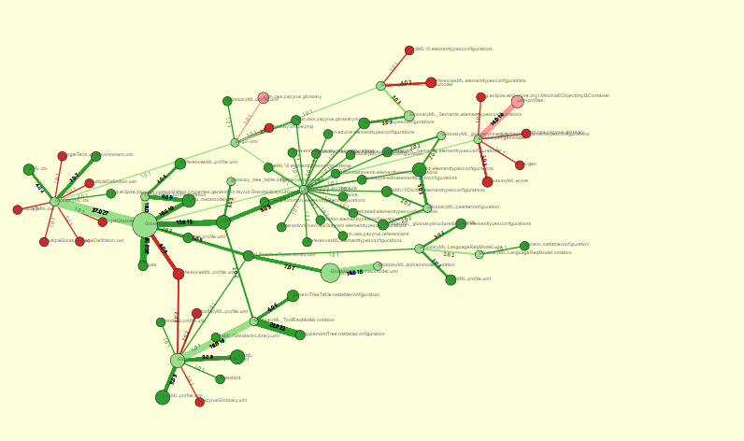
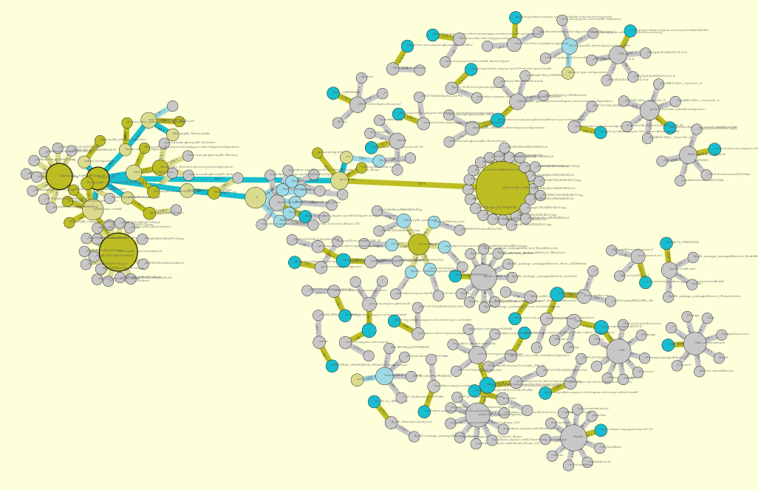
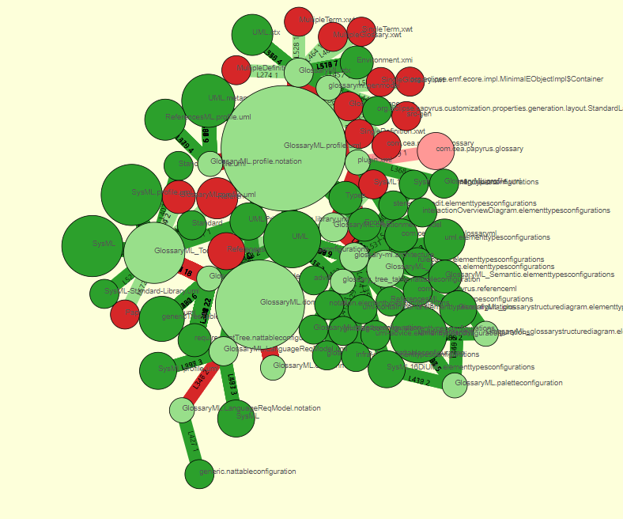
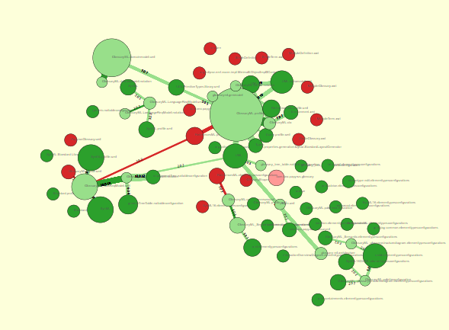
Complexity & Topology in
a Papyrus project
Topology
Exploring Papyrus DSL orchestration

Slide 12
Topology of
a Papyrus project
Topology
Exploring Papyrus DSL orchestration

Slide 13



















Topology of
a Papyrus project
Reference forensic
Exploring Papyrus DSL orchestration
The bigger an element,
The most accessed

Slide 14
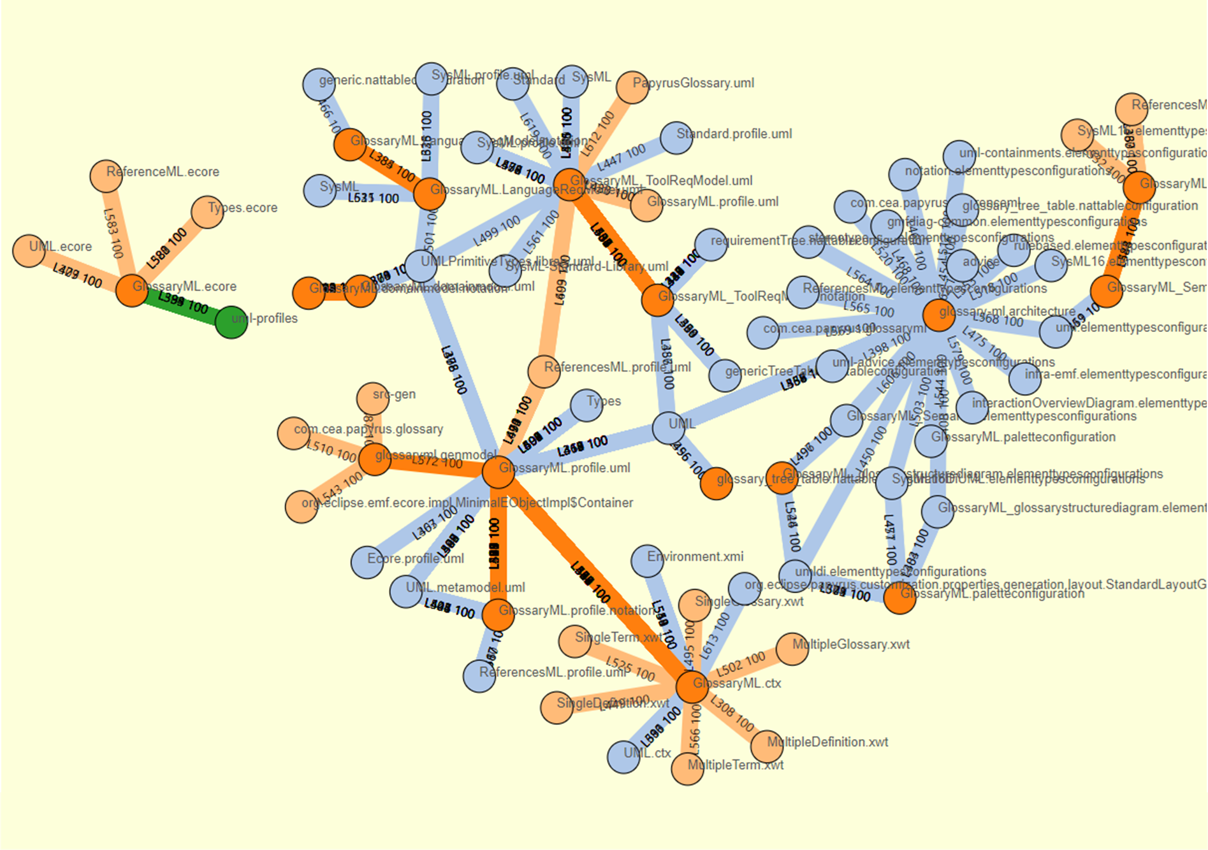
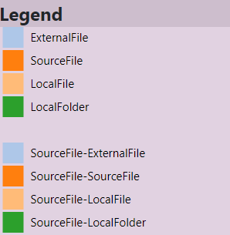
Complexity of
a Papyrus project
Reference forensic
Exploring Papyrus DSL orchestration

Slide 15
Complexity of
a Papyrus project
Reference forensic
Exploring Papyrus DSL orchestration
The largest a link
The most intense the relation

Slide 16
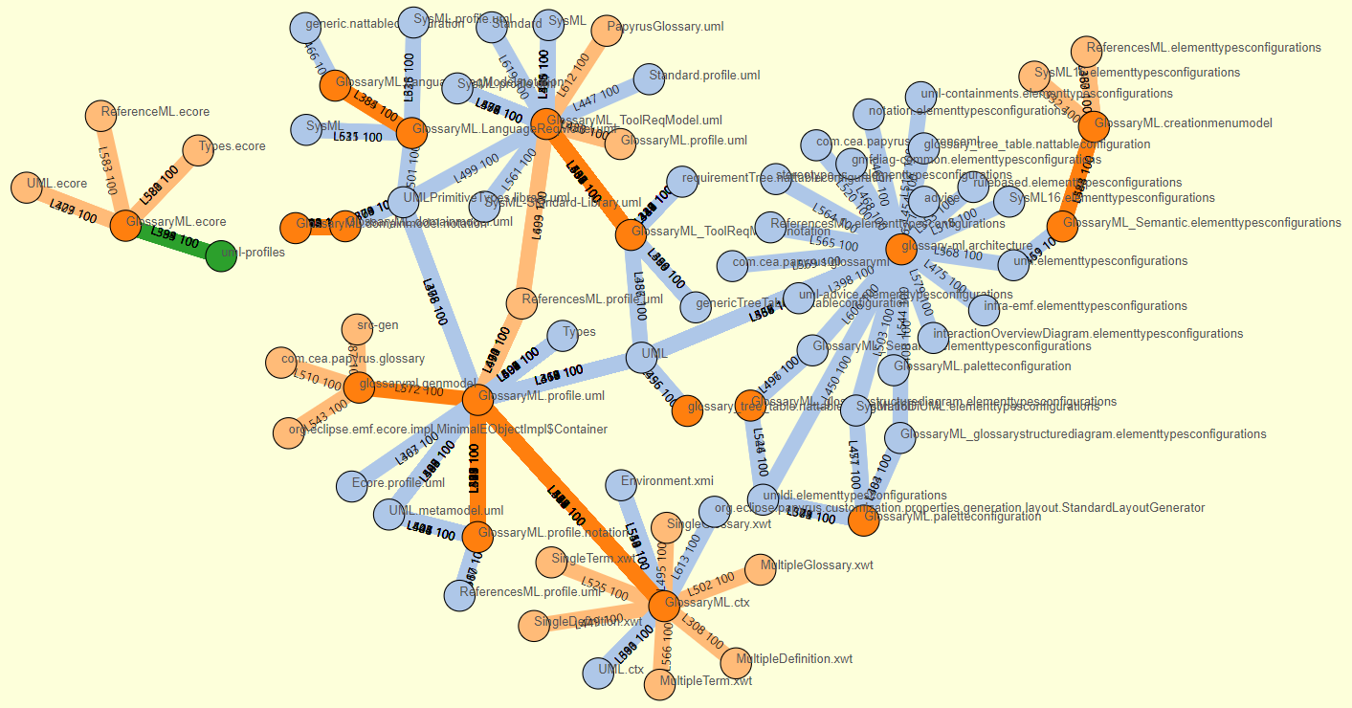
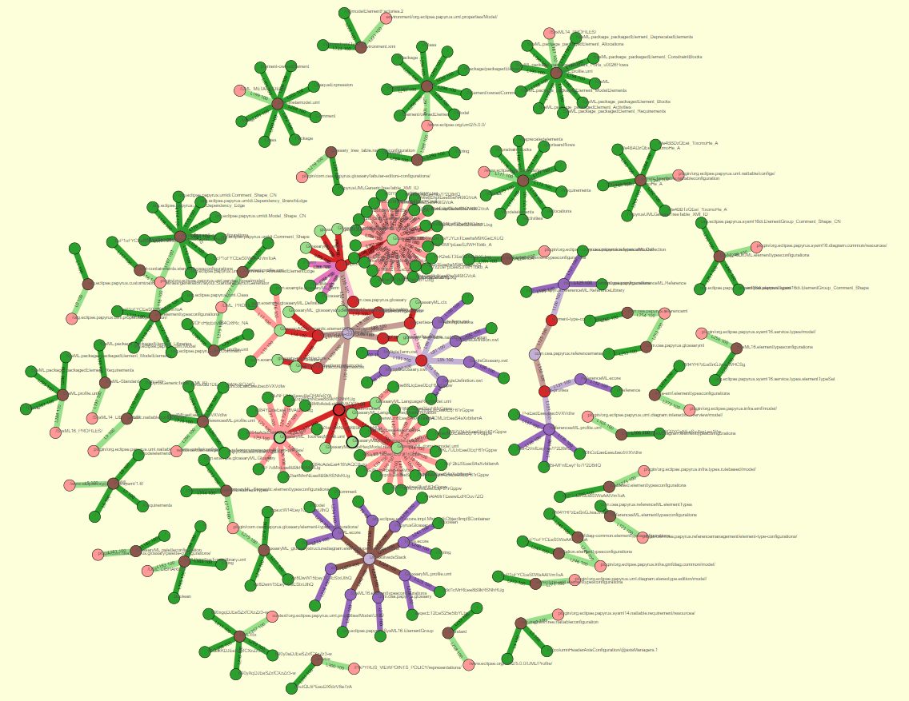
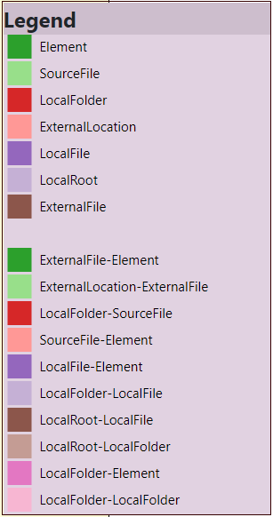
Complexity & Topology in
a Papyrus project
Reference forensic
Exploring Papyrus DSL orchestration
¿Topology & Complexity
in a single perspective?
¿?

Slide 17
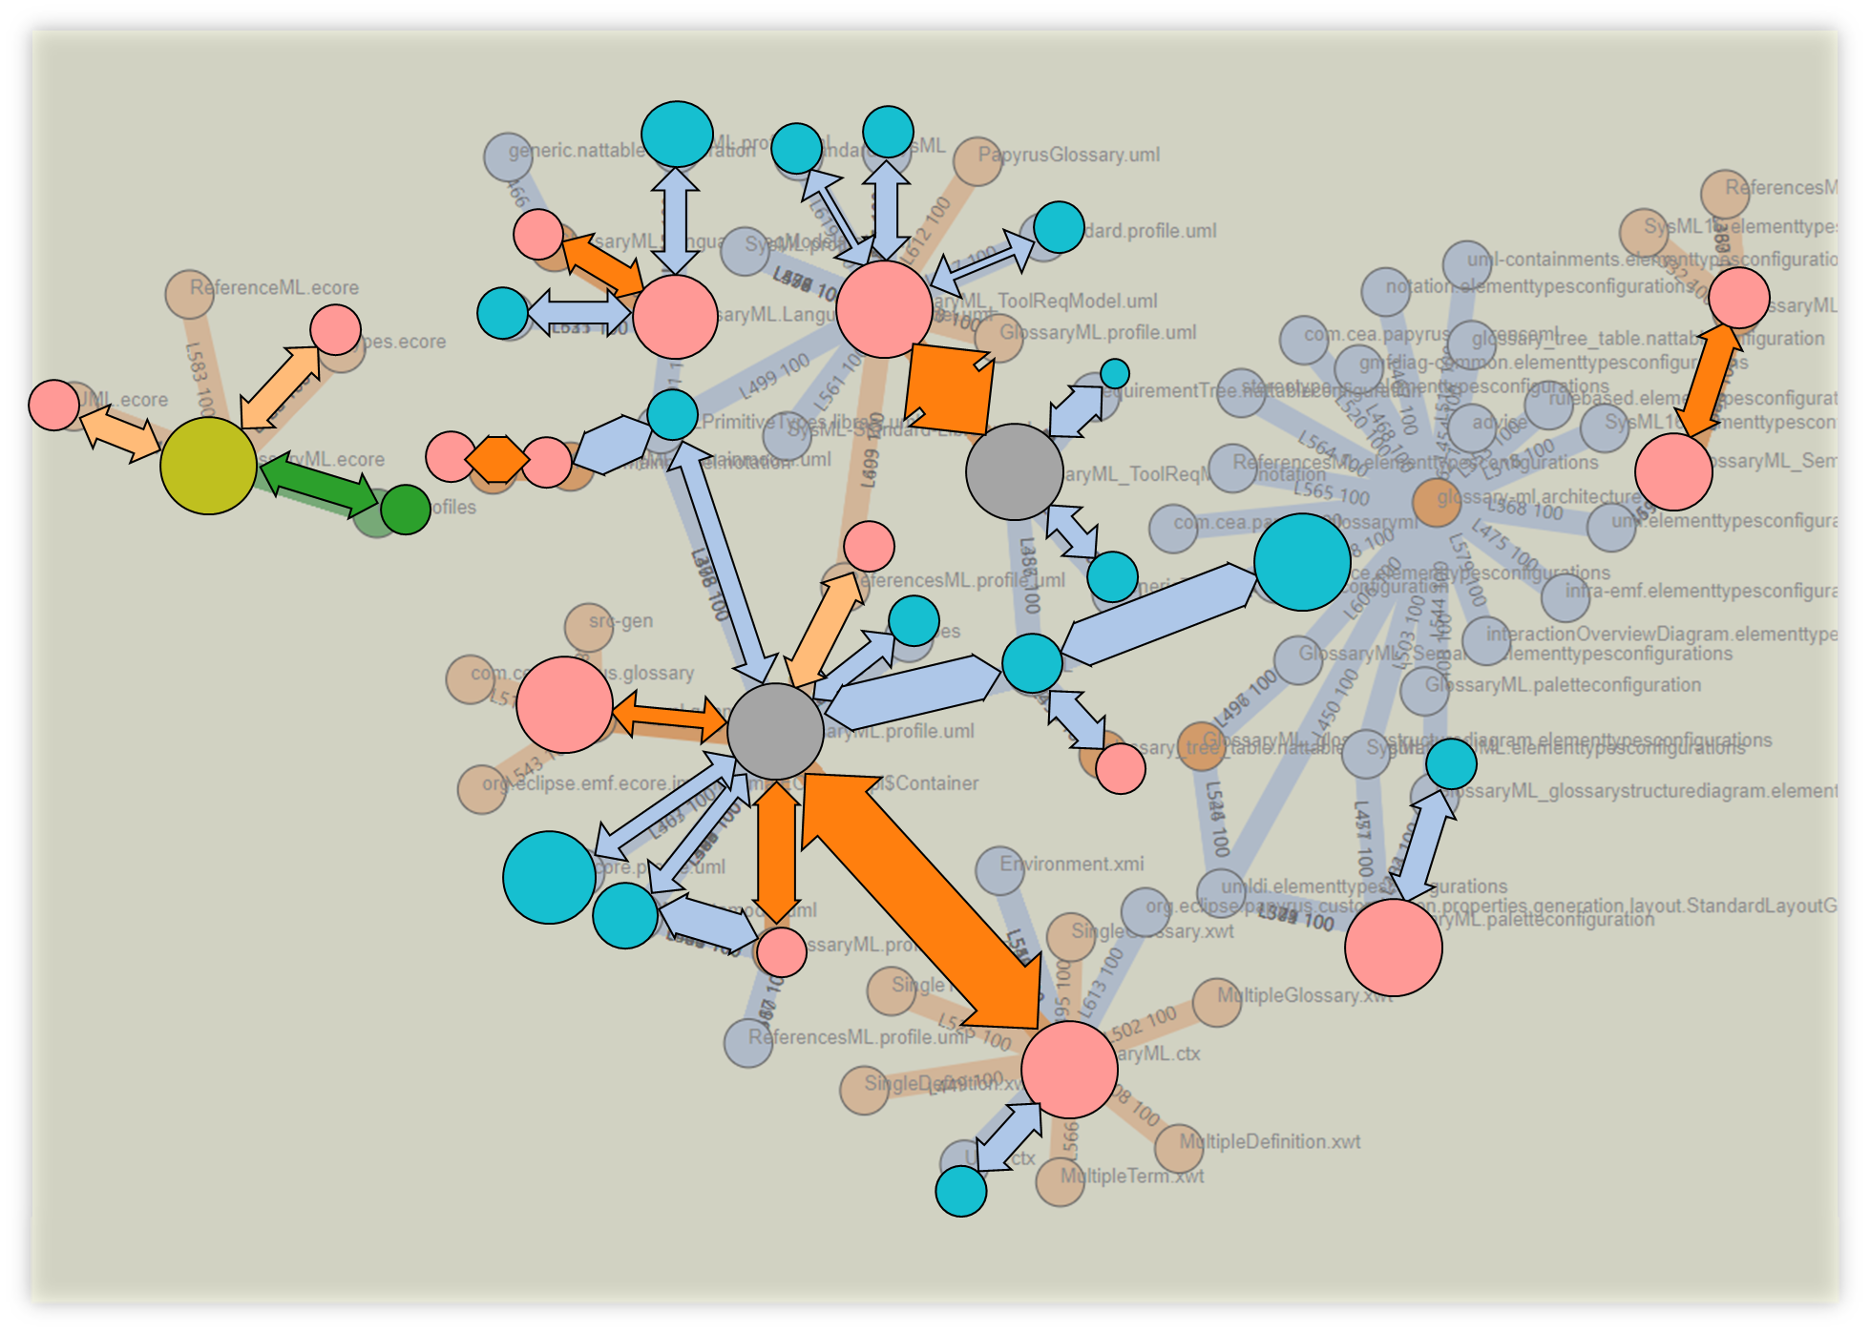
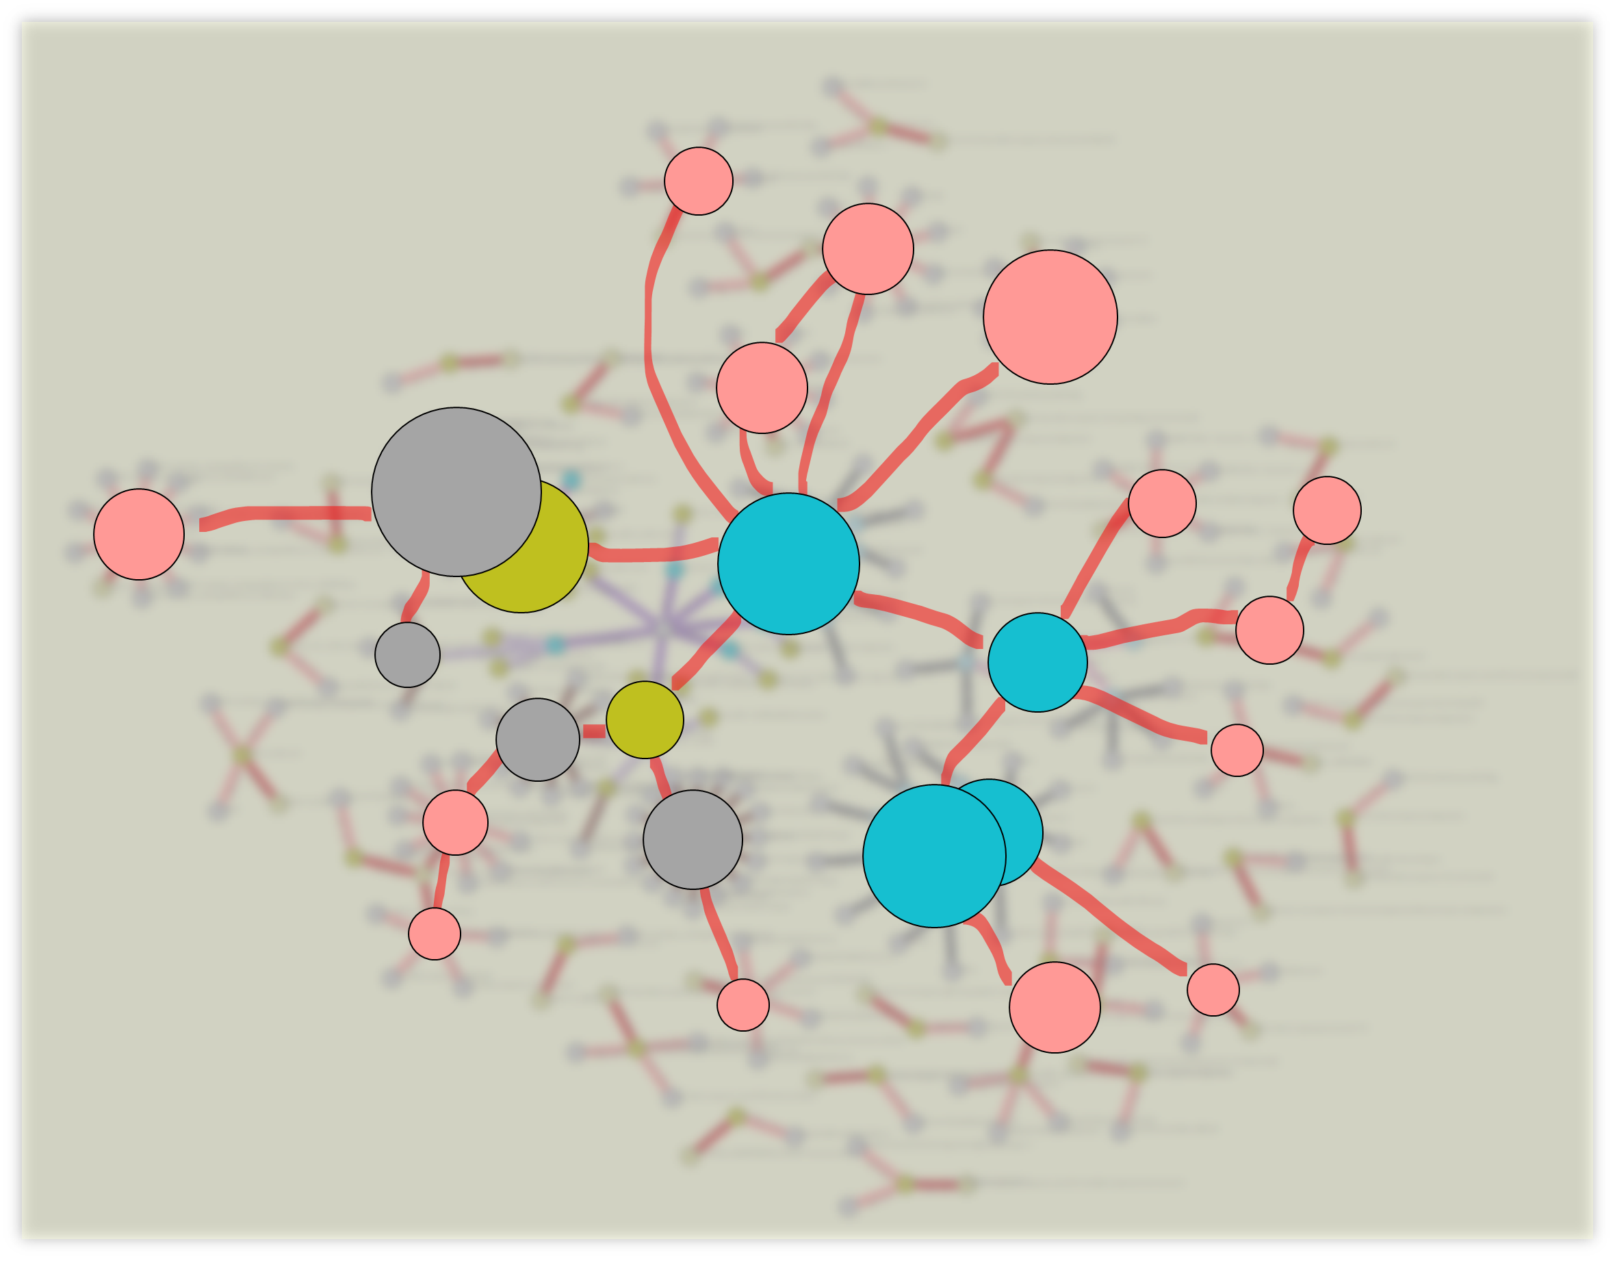
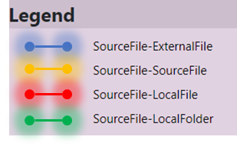
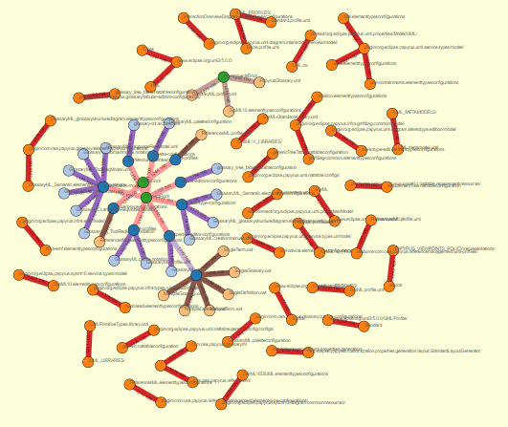
Intangible future.
Topology
Complexity
Reference forensic
Exploring Papyrus DSL orchestration

Slide 18
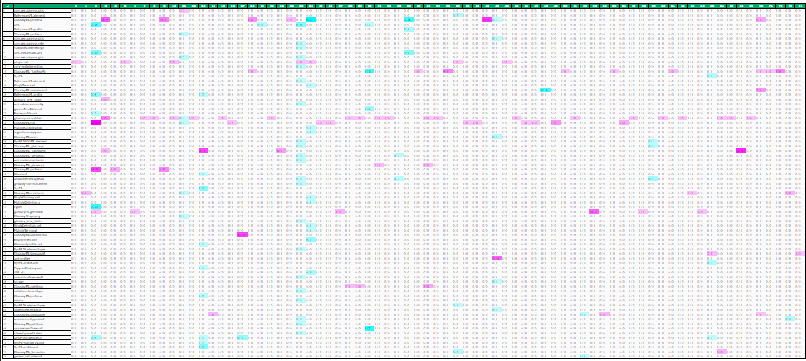
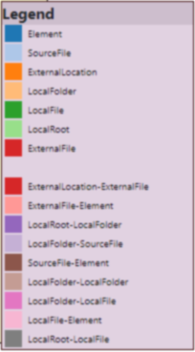
Complexity & Topology in
a Papyrus project
Reference forensic
Weighted adjacency matrix
A matrix heat chart
Exploring Papyrus DSL orchestration
Customization of views according to the "distance" between artefacts
Socio-technical traceability language
Confidence / Intensity valuation
Visualization parameters

Slide 19
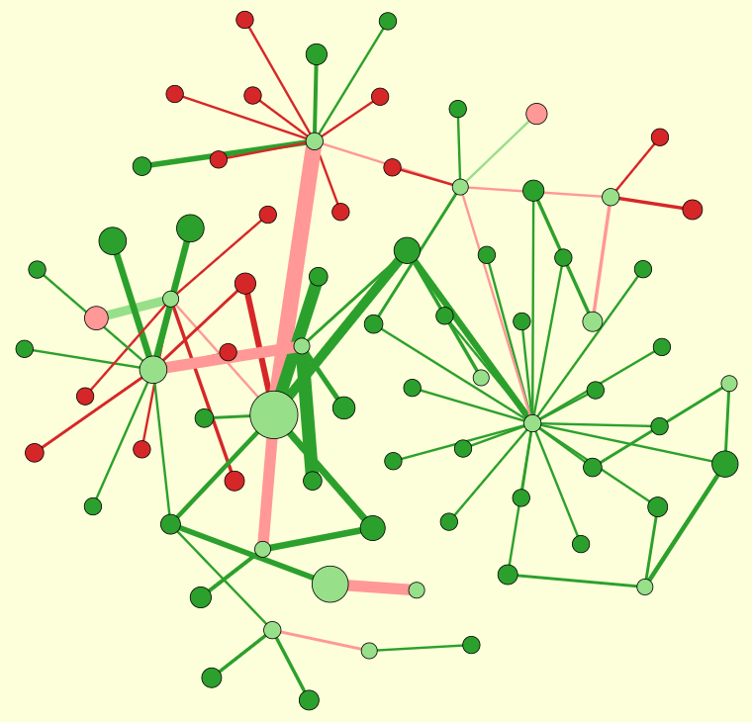
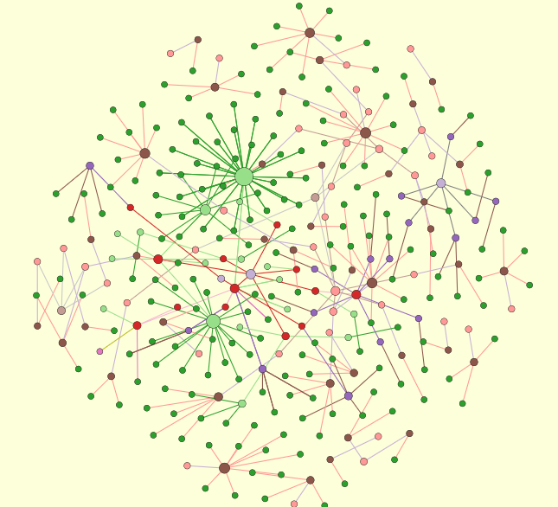








Complexity & Topology in a Papyrus project
2a
Complexity
Topology
Reference forensic
Exploring Papyrus DSL orchestration
Intensity Clusters
Hierarchical Trees

Slide 20

Complexity & Topology in a Papyrus project
Reference forensic
3
1
2a
4
Exploring Papyrus DSL orchestration
5
2b
6

Slide 21









Complexity & Topology in a Papyrus project
Semi-automated analysis
Reference forensic
Exploring Papyrus DSL orchestration

Slide 22


Complexity & Topology in a Papyrus project
Semi-automated analysis
Reference forensic
Exploring Papyrus DSL orchestration

Slide 23


Complexity & Topology in a Papyrus project
Semi-automated analysis
Reference forensic
Exploring Papyrus DSL orchestration

Slide 24



Complexity & Topology in a Papyrus project
Semi-automated analysis
Reference forensic
Exploring Papyrus DSL orchestration

Slide 25


Complexity & Topology in a Papyrus project
Semi-automated analysis
Reference forensic
Exploring Papyrus DSL orchestration

Slide 26
Complexity & Topology in a Papyrus project
Semi-automated analysis
Reference forensic
GlossaryML.profile.uml
Highest fan in
Exploring Papyrus DSL orchestration
ToolReq & Profiles
SysML elements
Architecture
& palettes
ElementTypeConfigurations

Slide 27


Complexity & Topology in a Papyrus project
Reference forensic
Semi-automated analysis
Semi-automated analysis
Exploring Papyrus DSL orchestration
Semi-automated analysis
Semi-automated analysis
Semi-automated analysis

Slide 28
Complexity & Topology in a Papyrus project
Reference forensic
Semi-automated analysis
Semi-automated analysis
Exploring Papyrus DSL orchestration
Semi-automated analysis
Semi-automated analysis
Semi-automated analysis

Slide 29
Orchestration for DSL modeling: A study of Papyrus
Papyrus modules & dependencies
Exploring Papyrus DSL orchestration

Slide 30
















Topology and complexity of Papyrus-based DSL creation: A semi-automated analysis of Papyrus DSL projects
1
2
3
4
Orchestrus: Analyzing Papyrus DSL artefacts relationship
·
Tracea
Papyrus DSL project
Relationship identification
TraceaML instantiation
Artefacls and links valuation
Semi-automated
analysis
XML et al.
a
d
Typed trace
Typed clusters
c
e
Trace
References
Java
XMI
f
h
b
g
Parsing
j
i
Modeling
Typing
Desiccation
Configuration
- Folders
- Dependencies
- Src-custom
- Specific formats
{Json}
{Json}
{Json}
{Json}
Configuration
- Clustering algos
- Algos parameters
- Clusters min size
Artefacts
Fragmentation and Relationships
Artefacts
Fragmentation and Relationships
List of references
Clusters
Papyrus persistence
Visualization with TraceaD3
JSon
Relationships
Fragmentation
Java
TraceaD3
Trace a
D3
Orchestrus
Sensitive areas
Interaction
- Browse & search
- Emphasize clusters
- Show paths
TraceaML
Notes:
30

Slide 31









Working space
Reference forensic
Exploring Papyrus typotopology
Topology
Intensity
Complexity
Fan-in
Clusters

Slide 32
Papyrus topology and complexity an automated overview
Deliverable 6
Traceα
Orchestration for DSL modeling
Inter-module connections
Edouard R. Batot
Mai 2022

Slide 33
Persistence break.
Folder
File
File
File
Elt
Elt
Folder
Elt
Elt
Elt
Folder
File
File
File
File
File
File
Elt
Elt
Elt
Elt
Elt
Elt
Elt
Elt
Elt
Elt
Elt
Elt
Elt
External Location
External Location
Elt
Elt
Elt
External Location
¿Resolution?
HREF
Protocol
://
location
name
#
innerlocation
URI

Slide 34


Intangible future.
Topology
Complexity
Reference forensic
Exploring Papyrus DSL orchestration

Slide 35
Topology and distance in a Papyrus project
Semi-automated analysis
Reference forensic
Exploring Papyrus typology

Slide 36

Java files
XML et al.
XMI
EMF Realm

Slide 37
Topology and distance in a Papyrus project
Reference forensic
Exploring Papyrus typology
data/input_trace_data.json&nc=4&lc=4

Slide 38


Reference identification and visualization
Reference forensic
Exploring Papyrus typology

Slide 39





Slide 40
Topology and distance in a Papyrus project
Reference forensic
Exploring Papyrus typology
The bigger an element,
The most accessed

Slide 41

Complexity of
a Papyrus project
Reference forensic
Exploring Papyrus typology

Slide 42
Reference plastic
Artefact
Artefact
Artefact
Protocol
External
Location
Local
Folder
Root
Location
Artefact
Context
resolves?
Name
Inner location
Artefact
External
File
exists?
Local
File
File Artefacts
Element
Precise
Artefact
EMF Realm

Slide 43







Topology and distance in a Papyrus project
Papyrus
Reference forensic
Exploring Papyrus typology
UML
SysML
GlossaryML
ReferenceML

Slide 44
EMF Realm

Slide 45

A study of Papyrus: Orchestration for DSL modeling
Inter-module connections
Impacted elements
Design
Code
Inter-module connections map
Profiling
Maps modules external dependencies
Eases exploration of dependencies
Guides type connections
Architecture
Element Type configuration
Palettization

Slide 46



A study of Papyrus: Orchestration for DSL modeling
Inter-module connections detailed
Design
Other modules
UML element
UML Primitives
Related
libraries
SysML element
XML et al.
SysML 1.6
View
Context
Design
Architecture
Profiling
Palettization
Code
Element Type configuration
Related project
Project
EMF Realm

Slide 47
A study of Papyrus: Orchestration for DSL modeling
Inter-module connections detailed
Module
Other modules
Root
Path to element
Path to element
Specific Element
Path to element
External location
Specific Element
Related
libraries
External location
Specific Element
View
Context
Design
Architecture
Profiling
Palettization
Code
Element Type configuration
Related project
Project
EMF Realm

Slide 48




Orchestration for DSL modeling: A study of Papyrus
Element type configurations:
from domain model to EMF representations
? Related projects ?
Glossary
DSL
Reference management DSL

Slide 49

Orchestration for DSL modeling: A study of Papyrus
Customization and dependencies

Slide 50



Orchestration for DSL modeling: A study of Papyrus
Papyrus external elements
Missing
Profile / Definition ?
Domain – SysML
Dependency

Slide 51


Orchestration for DSL modeling: A study of Papyrus
EMF ResourceSets & Resources
Definition
Usages
Related project
CreationMenu resources
Architecture resources

